Slide 1
HSSF – NYHDiF Update www.england.nhs.uk/hssf/
Dean Davidson
Digital Transformation & Informatics Lead
May 2021

Slide 2
What is HSSF?
HSSF is a central implementation vehicle for national policy with an ability to rapidly respond to new requirements and ensure the Market offerings reflect up to date health & care strategy:
Give health systems quick and easy access to the market for services that enable them to deliver more integrated care;
Bring suppliers onto a national framework agreement enabling the application of key standards through the contract, supporting visibility and consistency in expectations of the market;
Support the implementation of key national policies and programmes (for example the scaling of the Global Digital Exemplars and creation of Local Health and Care Records) that are critical to delivery of the Five Year Forward View and the Long Term Plan.

Slide 3
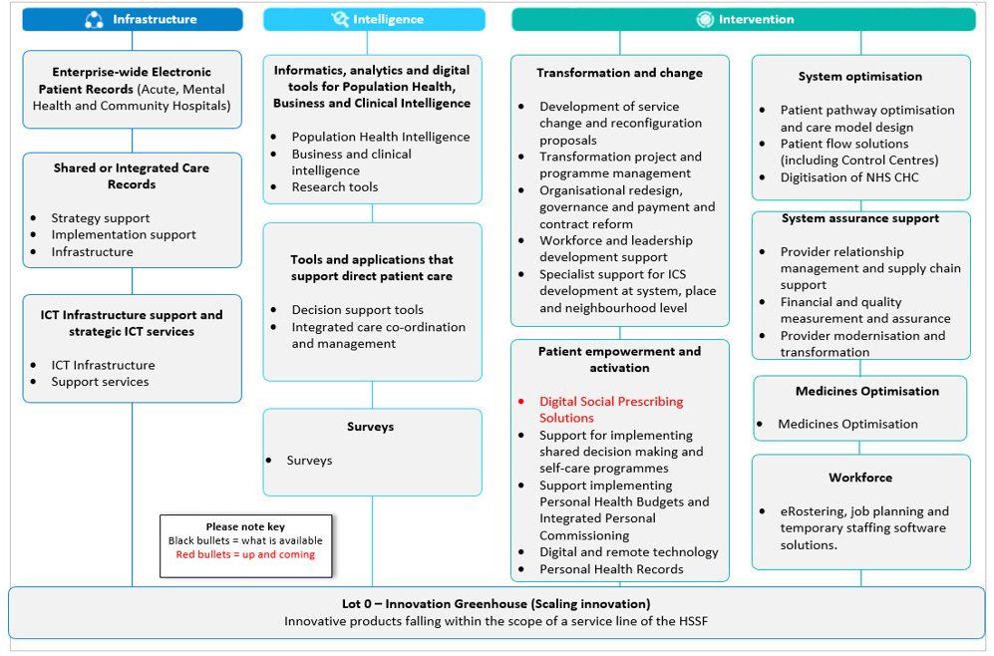
Framework Scope
Supported Self Management
2021Planned Service Lines:
OH, LMS & Recruitment Systems
Digital Urgent & Emergency Care
Single Sing On Solutions
Social Care Record
Maternity Solutions
Financial Wellbeing & Salary Advance
Digital Staff Passport

Slide 4
How does HSSF work?
The HSSF was created to be as flexible as possible for suppliers and customers, recognising that the needs of Integrated Care Systems are still evolving.
It has therefore been designed in a way which:
Allows it to be refreshed on a regular basis to allow for new market entrants and ensure the scope and contract can be reviewed and updated to reflect emerging policy requirements and the latest standards;
Allows refresh at different intervals for different services, remaining dynamic to changing needs and allowing quick establishment of new and emerging requirements;
Allows suppliers to bid at a service level, supporting niche and smaller suppliers in bidding to achieve Framework accreditation and providing greater access to the market;
Covers a broad range of requirements and tests supplier capability at a high level, allowing local systems to purchase under the Framework based on locally defined requirements and with support from the centre;
Allows customers to call-off across a range of solutions in a single procurement with suppliers able to respond directly on their own (where accredited for all relevant services) or in partnership with other accredited suppliers.

Slide 5
Access to HSSF
The HSSF is open to a wide range of public sector organisations, including organisations working within:
STP/ICS such as CCGs or PCNs,
NHS Trusts
LAs.
Solutions are purchased following a further competition through the Framework
This competition process allows users to:
Define what services they need;
Assess and evaluate the solution that works best for them; and
Consider how what they are buying fits into their future structure
whilst having the assurance of a nationally agreed contract with which to hold suppliers to account.

Slide 6
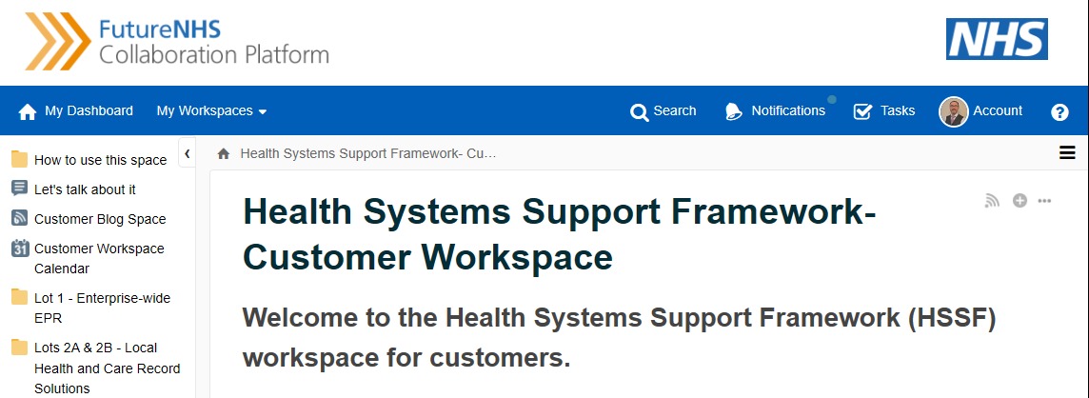
Accessing the NEW HSSF workspace
Procurements through HSSF are supported by a central team who can provide procurement advice & links to other national leads/subject matter experts where required.
We also have a range of further guidance, tools and templates to support you in any procurement process.
For further information contact the team at hssf.enquiries@nhs.net
You can also review further detail on the Framework scope and suppliers on the Framework via our website www.england.nhs.uk/hssf

Slide 7
Shared or Integrated Care Records
Local & national Strategic development support
Local Health and Care Record programme support (LHCR)
Shared health and care record provision (ShCR)
Support for Implementation, project & change management
Open APIs supporting CareConnect, FHIR, RESTful interfaces & OAuth profiles
infrastructure services & secure data collection software
De-id & Re-id services & Secondary use data

Slide 8
SICR Requirements
Strategic development of local, system, regional or national technology architecture and implementation strategy for interoperability and information exchanges.
Implementation support for the provision of PMO & dedicated support to ensure new shared or integrated care record solution infrastructure is implemented.
Infrastructure & secure software, cloud services and / or hardware to enable real-time integration, exchange and storage of patient data as part of a SICR solution, Including LHCR solutions: delivery of longitudinal care records for the delivery of integrated care; DoS; ShCR; FHIR; CDA; OpenEHR; Open APIs SICR; Structured medications data; PHR data exchange and secondary use for research & PHM capabilities (inc De-id / Re-id)

Slide 9
HSSF Standards
Framework Agreement & Call-Off Contact
Information Standards Notices
Environmental Standards
Cyber Security, IG & DSPT
IT Hardware Safety Standards
Interoperability Standards
Providers of Online Services
Technology & Digital Services Practice
ML, AI & Augmented Intelligence
Information Standards Compliance
Standards specified by MHRA
Digital, Data & Technology Standards
Clinical Risk Management
Open Data Standards & Standards Hub
PRSB Common Core Information
Tech Architecture & Internet First
LHCR Technical Capabilities
Accessible Digital Standards
Digital Assessment Questionnaire*
Service Management Software
NHSX Standards Catalogue (once published)
*= DAQ to be replaced by Digital Technology Assessment Criteria (DTAC)

Slide 10
HSSF Webinar Series
Webinars areas:
HSSF & NHSX Standards Framework – 3rd Feb 2020 (recorded)
Mental Health EPR solutions: What good looks like – 27th Feb (recorded)
SMOMED Clinical Terminology – 1st Jul (recorded)
Shared Care Records – 24th Aug (recorded)
Internet First Policy & API approach – 9th Sept (recorded)
NHS Login accreditation & NHS App access – 7th Oct
Digital Continuing Healthcare – 25th May 2021
Information Governance & Access Controls
Artificial Intelligence Buyers Guide
Digital & Technology Standards
Workforce Development & the NHS People Plan
Medical Devices Regulation accreditation
A practical guide to procurement (using HSSF)
Further competition process and call-off rules
If you would like to register your interest please email:
hssf.enquires@nhs.net

Slide 12
Contact details
For more information about the Framework, access to guidance documents, the catalogue of suppliers etc. or for general enquiries please email:
PHM Support Team
Email: hssf.enquiries@nhs.net
Website: https://www.england.nhs.uk/hssf/
Dean Davidson
Digital Transformation & Informatics Lead
Population Health Management Support
Primary Care & System Transformation,
NHS England - Email: dean.davidson3@nhs.net

Slide 13
Annex 1: Information on PHM:
Join our FutureNHS on-line community – for discussion forums, news, webinars, information exchange and helpful resources
Email england.phmsupport@nhs.net to register

Slide 14
Annex 2: Data and Analytics

Slide 15
Get involved in Data & Analytics

